Slide 1
Smart Agriculture System Based On IoT
by ADDANKI NAVEEN
GAYATRI VIDYA PARISHAD COLLEGE OF ENGINEERING(A)
B-Tech 3rd year ECE
Visakhapatnam
17131a0401@gvpce.ac.in

Slide 2
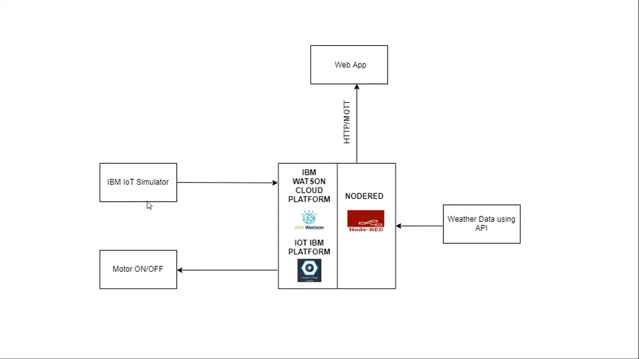
Project flow over view

Slide 3
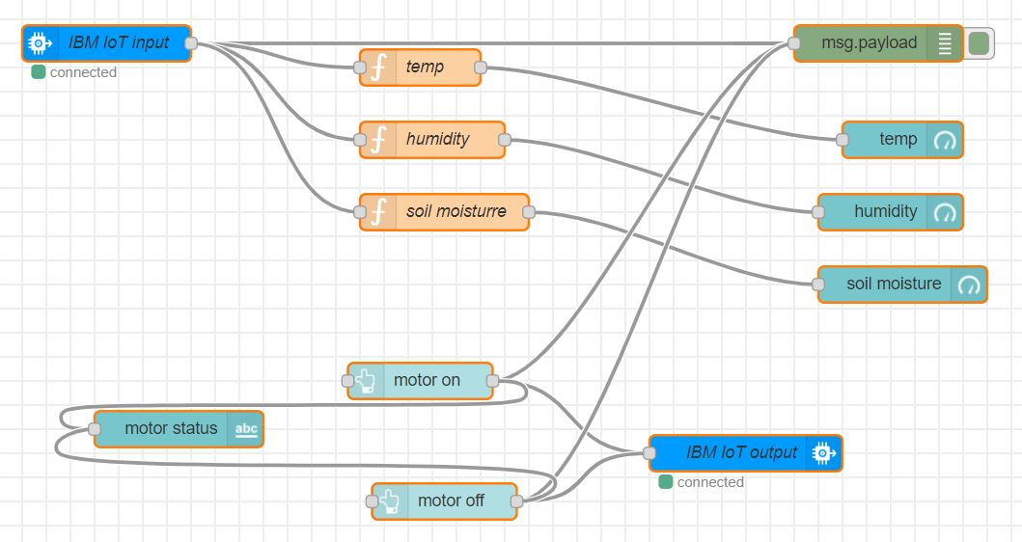
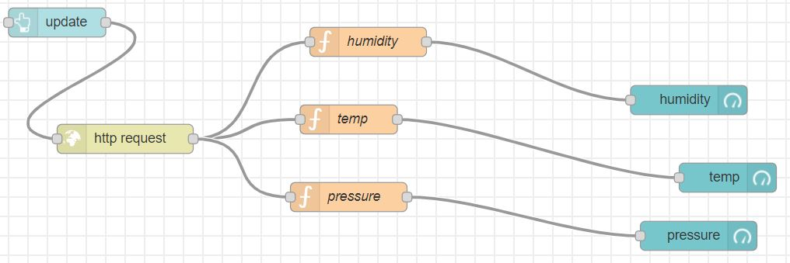
NODE-RED FLOWS

Slide 4
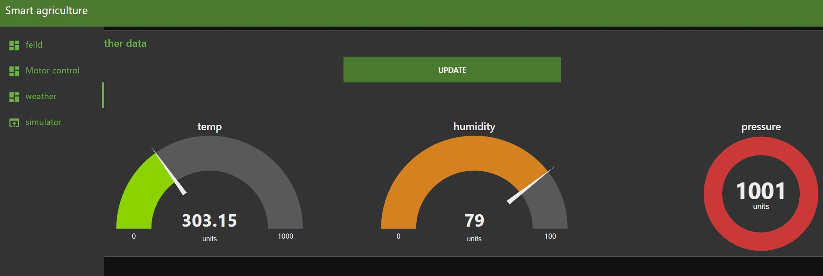
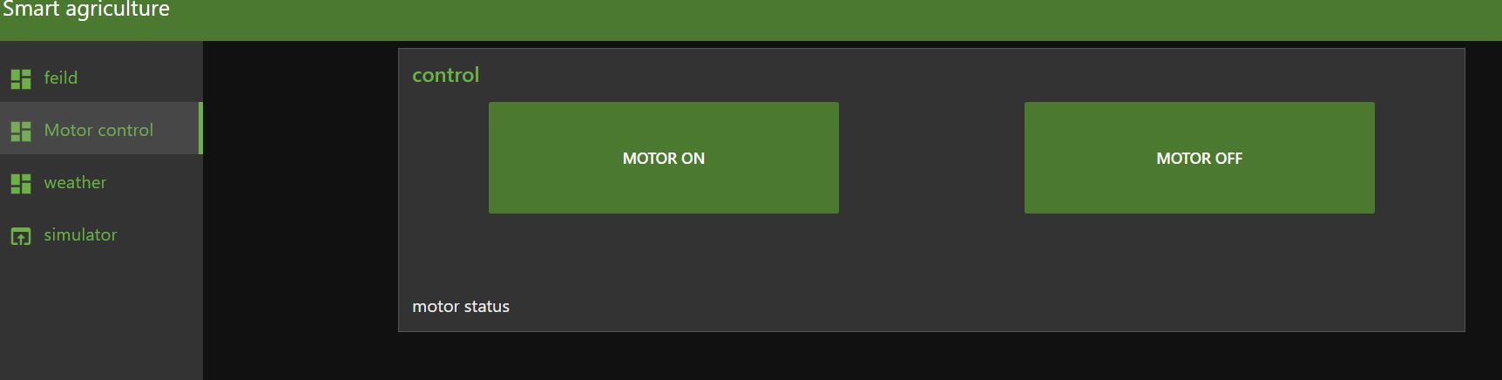
Dashboard view

Slide 5

Project scope and Conclusions
PROJECT SCOPE :
There is the scope to extend this for water management.
We can develop it to Pest management system as well.
We can combined this with different sensors and make more usable.
CONCLUSIONS :
We can predict field conditions.
Increased productivity.
Water conservation.
Profits for farmers.
Sustain high yield.
Alert on local climatic conditions.

